Slide 1
Introduction to Software Engineering

Slide 2
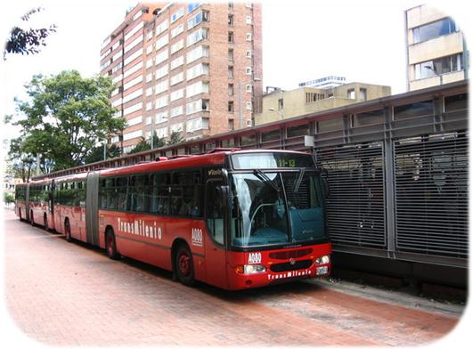
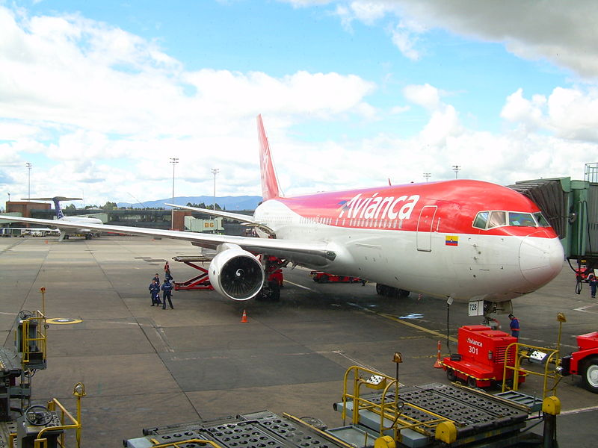
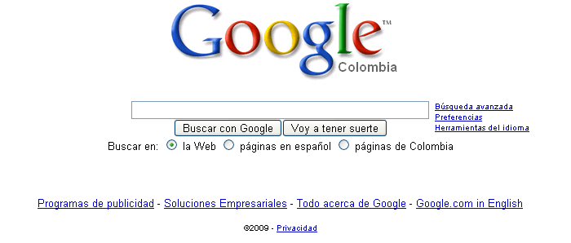
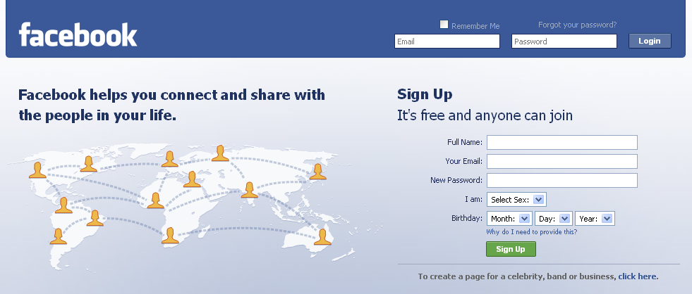
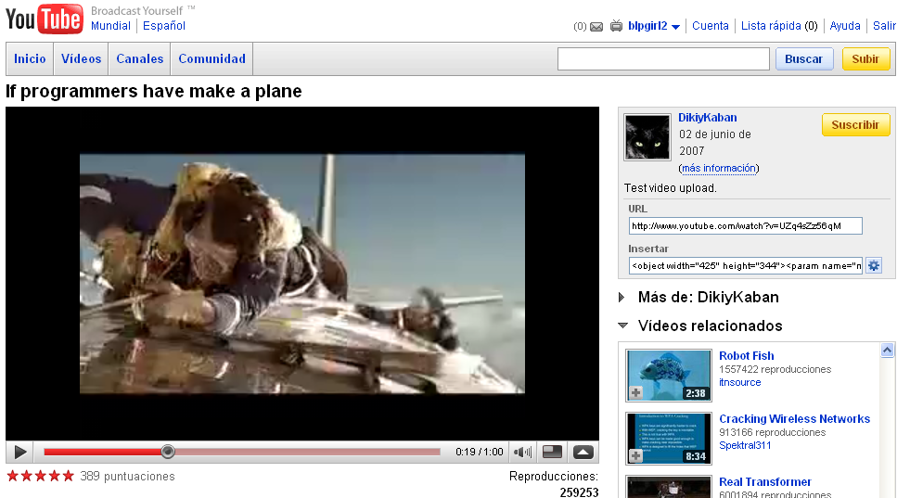

Software engineering is an engineering discipline which is concerned with all aspects of software production
Software products may be developed for a particular customer or may be developed for a general market or may be developed for social work, etc...
Importance of software: Software can greatly impact any aspect of society. We can find software almost everywhere like:

Slide 3
Problems in software development
Common issues:
The final Software doesn´t fulfill the needs of the customer.
Hard to extend and improve: if you want to add a functionality later is mission impossible.
Bad documentation.
Bad quality: frequent errors, hard to use, ...
More time and costs than expected

Slide 4
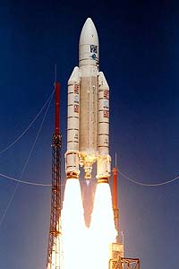
Some Famous Software Failure:
Ariane 5
It took the European Space Agency 10 years and $7 billion to produce Ariane 5, a giant rocket capable of hurling a pair of three-ton satellites into orbit with each launch and intended to give Europe overwhelming supremacy in the commercial space business.
The rocket was destroyed after 39 seconds of its launch because of small design errors (A critical numeric overflow occurred when the system tried to convert a high-velocity value into a smaller data type.)
Cause: design errors in the software

Slide 5
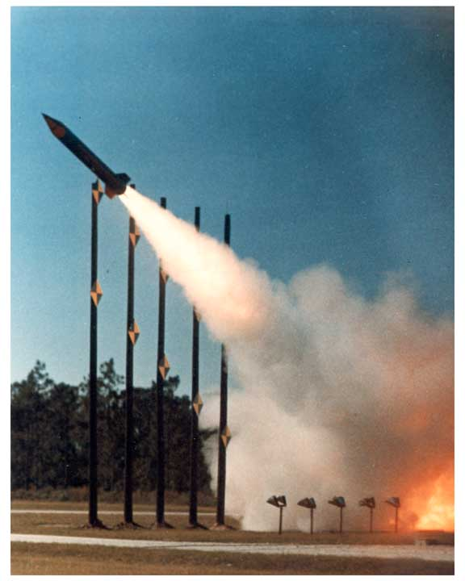
Cont....
The Patriot Missile
First time used in Gulf war
Used as a defense from Iraqi Scud missiles
Failed several times including one that killed 28 US soldiers in Dhahran, Saudi Arabia
Reasons:
A small timing error in the system’s clock accumulated to the point that after 14 hours, the tracking system was no longer accurate. In the Dhahran attack, the system had been operating for more than 100 hours.

Slide 6

Cont....
Y2K problem: The Y2K problem, also known as the millennium bug.
Many computer programs were written in the 1960s using a two-digit code for the year, such as “99” instead of “1999”.
This meant that the year 2000 would be written as "00".

Slide 7
Cont....
Financial Software
Many companies have experienced failures in their accounting system due to faults in the software itself. The failures range from producing the wrong information to the whole system crashing.
Windows XP
Microsoft released Windows XP on October 25, 2001.
On the same day company posted 18 MB of compatibility patches on the website for bug fixes, compatibility updates, and enhancements.
Two patches fixed important security holes.

Slide 8
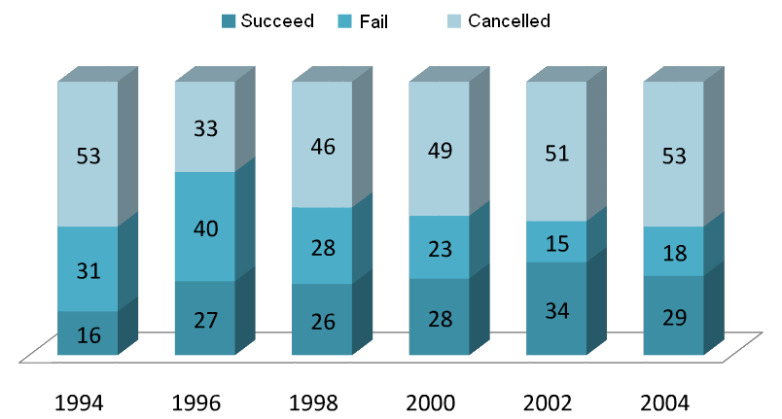
Software industry is in Crisis!
This is the SORRY state of Software Development!
Chaos Report (2006), The Standish Group International

Slide 9
Cont....
The recent Chaos report (2021) found that 29% of projects were successful, 52% were challenged, and 19% were failures
Factors Contributing to the Software Crisis:
Incomplete requirements
Lack of user involvement
Lack of resources
Unrealistic expectations
Lack of executive support
Changing requirements and specifications
Lack of planning

Slide 10
Conclusion
Programming is NOT enough!
It is not enough to do your best: you must
Know what to do, how to do and THEN do your best.
-- W. Edwards Deming
Solution..?

Slide 11
Software Engineering
What is it?
Software engineering is the systematic, disciplined, and quantifiable application of engineering to the development, operation, and maintenance of software.
-As per IEEE Standard
Notes:
In simple terms, is the study and application of methodologies to develop quality software that fulfill customer needs.

Slide 12
Software Engineering Objetive:
To produce software that is:
Complete: good documentation, fulfill customer needs.
On time: is deliver at the established date.
Budget: Within budget
Maintainable: Product should be maintainable
Reliable: doesn´t crash.
To achieve these objectives a team work is required.

Slide 13

The team

Slide 14
Cont...
Software development engineering approach:
Attempt to estimate cost/effort
Plan and schedule work
Involve user in defining requirements
Identify stages in development
Define clear milestone so that progress can be measured
Define deliverables
Plan extensive testing

Slide 15
Job of Software Developer is Difficult
Dealing with users
Ill-defined requirements
Concern with ease-of-use and response time
Dealing with technical people
- Concerned with coding, database, file structure, etc...
Dealing with Management
- Concerned with return on their investment
- Cost benefit analysis
- Schedule

Slide 16
Stages for software development
Requirements Analysis
Software Design
Coding
Testing
Maintenance
This stages is known as Software Development Life Cycle (SDLC) model.

Slide 17
What is software?
Programs
Documentation
Operating Procedures
Software=Program+Documentation+Operating Procedures
Components of software

Slide 18
Documentation consists of different types of manuals are
Formal Specification
Analysis
/Specification
Context-
Diagram
Data Flow Diagrams
Flow Charts
Design
Entity-Relationship Diagram
Documentation
Manuals
Source Code Listings
Implementation
Cross-Reference Listing
Test Data
Testing
Test Results
List of documentation manuals

Slide 19
Documentation consists of different types of manuals are
System Overview
User Manuals
Beginner’s Guide Tutorial
Reference Guide
Operating Procedures
Installation Guide
Operational Manuals
System
Administration Guide
List of operating procedure manuals.

Slide 20
Software Product
Software product is a product designated for delivery to the user
source codes
documents
reports
manuals
object codes
plans
data
test results
test suites
prototypes

Slide 21
Software Process
The software process is the way in which we produce software.
Why is it difficult to improve software process ?
Not enough time
Lack of knowledge
Wrong motivations
Insufficient commitment

Slide 22
Software Process
Improved future state
Process improvement begins
Initial state state
Productivity
Do not quit here!
Learning curve
Time

Slide 23
Software Characteristics:
Software does not wear out.
Burn-in
phase
Wear out
phase
Useful life
phase
Failure Intensity
Time

Slide 24
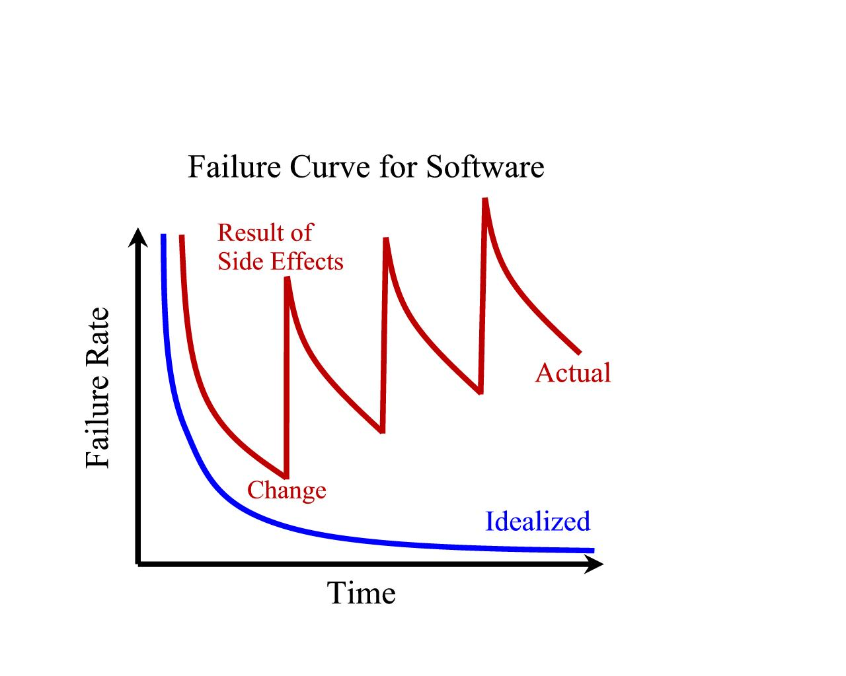
Software Characteristics:
Software is not manufactured
Reusability of components
Software is flexible

Slide 25
Software Characteristics:
Comparison of constructing a bridge vis-à-vis writing a program.
Sr.No | Constructing a bridge | Writing a program
1.
2.
3.
4.
5.
6.
7.
Only some parts of the problem are understood, others are not
The problem is well understood
There are many existing bridges
Every program is different and designed for special applications.
The requirement for a bridge typically do not change much during construction
Requirements typically change during all phases of development.
The strength and stability of a bridge can be calculated with reasonable precision
Not possible to calculate correctness of a program with existing methods.
When a bridge collapses, there is a detailed investigation and report
When a program fails, the reasons are often unavailable or even deliberately concealed.
Engineers have been constructing bridges for thousands of years
Developers have been writing programs for 50 years or so.
Materials (wood, stone,iron, steel) and techniques (making joints in wood, carving stone, casting iron) change slowly.
Hardware and software changes rapidly.

Slide 26
The Changing Nature of Software
System
Software
Real Time Software
Engineering and Scientific
Software
Embedded Software
Web based
Software
Business
Software
Artificial Intelligence
Software
Personal Computer Software

Slide 27
The Changing Nature of Software
Trend has emerged to provide source code to the customer and organizations.
Software where source codes are available are known as open source software.
Examples
Open source software: LINUX, MySQL, PHP, Open office, Apache webserver etc.

Slide 28
Software Myths (Management Perspectives)
Management may be confident about good standards and clear procedures of the company.
But the taste of any food item is in the eating; not in the Recipe !

Slide 29
Software Myths (Management Perspectives)
Company has latest computers and state-of-the-art software tools, so we shouldn’t worry about the quality of the product.
The infrastructure is only one of the several factors that determine the quality of the product!

Slide 30
Software Myths (Management Perspectives)
Addition of more software specialists, those with higher skills and longer experience may bring the schedule back on the track!
Unfortunately, that may further delay the schedule!

Slide 31
Software Myths (Management Perspectives)
Software is easy to change
The reality is totally different.

Slide 32
Software Myths (Management Perspectives)
Computers provide greater reliability than the devices they replace
This is not always true.

Slide 33
Software Myths (Customer Perspectives)
A general statement of objectives is sufficient to get started with the development of software. Missing/vague requirements can easily be incorporated/detailed out as they get concretized.
If we do so, we are heading
towards a disaster.

Slide 34
Software Myths (Customer Perspectives)
Software with more features is better software
Software can work right the first time
Both are only myths!

Slide 35
Software Myths (Developer Perspectives)
Once the software is demonstrated, the job is done.
Usually, the problems just begin!

Slide 36
Software Myths (Developer Perspectives)
Software quality can not be assessed before testing.
However, quality assessment techniques
should be used through out the
software development life cycle.

Slide 37
Software Myths (Developer Perspectives)
The only deliverable for a software development project is the tested code.
Tested code is only one of the deliverable!

Slide 38
Software Myths (Developer Perspectives)
Aim is to develop working programs
Those days are over. Now objective is to
develop good quality maintainable
programs!

Slide 39
Some Terminologies
Deliverables and Milestones
Different deliverables are generated during software development. The examples are source code, user manuals, operating procedure manuals etc.
The milestones are the events that are used to ascertain the status of the project. Finalization of specification is a milestone. Completion of design documentation is another milestone. The milestones are essential for project planning and management.

Slide 40
Some Terminologies
Product and Process
Product: What is delivered to the customer, is called a product. It may include source code, specification document, manuals, documentation etc. Basically, it is nothing but a set of deliverables only.
Process: Process is the way in which we produce software. It is the collection of activities that leads to (a part of) a product. An efficient process is required to produce good quality products.
If the process is weak, the end product will undoubtedly suffer, but an obsessive over reliance on process is also dangerous.

Slide 41
Some Terminologies
Measures, Metrics and Measurement
A measure provides a quantitative indication of the extent, dimension, size, capacity, efficiency, productivity or reliability of some attributes of a product or process.
Measurement is the act of evaluating a measure.
A metric is a quantitative measure of the degree to which a system, component or process possesses a given attribute.

Slide 42
Some Terminologies
Software Process and Product Metrics
Process metrics quantify the attributes of software development process and environment;
whereas product metrics are measures for the software product.
Examples
Process metrics: Productivity, Quality, Efficiency etc.
Product metrics: Size, Reliability, Complexity etc.

Slide 43
Some Terminologies
Productivity and Effort
Productivity is defined as the rate of output, or production per unit of effort, i.e. the output achieved with regard to the time taken but irrespective of the cost incurred.
Hence most appropriate unit of effort is Person Months (PMs), meaning thereby number of persons involved for specified months. So, productivity may be measured as LOC/PM (lines of code produced/person month)

Slide 44
Some Terminologies
Module and Software Components
There are many definitions of the term module. They range from “a module is a FORTRAN subroutine” to “a module is an Ada Package”, to “Procedures and functions of PASCAL and C”, to “C++ Java classes” to “Java packages” to “a module is a work assignment for an individual developer”. All these definition are correct. The term subprogram is also used sometimes in place of module.

Slide 45
Some Terminologies
“An independently deliverable piece of functionality providing access to its services through interfaces”.
“A component represents a modular, deployable, and replaceable part of a system that encapsulates implementation and exposes a set of interfaces”.

Slide 46
Some Terminologies
Generic and Customized Software Products
Generic products are developed for anonymous customers. The target is generally the entire world and many copies are expected to be sold. Infrastructure software like operating system, compilers, analyzers, word processors, CASE tools etc. are covered in this category.
The customized products are developed for particular customers. The specific product is designed and developed as per customer requirements. Most of the development projects (say about 80%)come under this category.

Slide 47
Role of Management in Software Development
Factors
People
Project
Product
Process

Slide 48
Role of Management in Software Development
People
1
Project
4
Dependency
Order
2
Product
3
Process

Slide 49
References
https://www.geeksforgeeks.org/
https://www.javatpoint.com/
fundamentals-of-software-engineering-fourth-edition-rajib-mall.

